Slide 1
Free Energy
and
Chemical Thermodynamics
Ch 5
In Ch 4, we applied laws of thermodynamics to cyclic processes (reversible): energy and entropy remain unchanged at the completion of cycle
But many thermodynamic processes are irreversible (non-cyclic) – for example chemical reactions
Topic of this chapter is
“How to apply thermodynamic laws to non-cyclic processes
Complications:
Most often these systems are not isolated
  Interact thermally and often mechanically with surrounding
  Energy of the system is not fixed, rather temperature is fixed
  (for thermal interactions) or/and volume is fixed (for mechanical interactions)
  Most of time Pressure is fixed rather than volume

Slide 2


Therefore, we need to develop tools to understand constant-temperature and constant-pressure processes
Free energy as variable
We already know Enthalpy
$$H=U+PV$$
Enthalpy is total energy needed to create a system out of nothing and put it into environment (under constant Pressure)
$$dH=dU+PdV$$
For constant P
If you annihilate a system, you can recover energy that is equal to enthalpy
If environment is constant-temperature, the system can extract heat from the environment for free.
And if annihilate the system, we generally, can not recover all energy as work b/c we have to dispose of its entropy by dumping heat into its environment.
Therefore, we need two more useful quantities related to energy
Helmholtz Free Energy, F
Gibb’s Free Energy, G

Slide 3





Helmholtz Free Energy, F
Total energy needed to create a system, U – heat that you can get free from environment at constant Temperature
$$F=U−TS$$
$T∆S=TS as ∆S=S−S_{0}$, assuming $S_{0}=0$
According to Helmholtz: F is the energy that must be provided to create a system from nothing
OR
If you annihilate the system, the energy that can be obtained back as work since you must dump some heat TS into environment to get rid of system’s entropy.
So available (or Free) energy is F (not U)
On the other hand, if system is under constant Pressure and Temperature
(Both P and T are constant)
The work needed to create a system (the work you can recover when annihilate the system) is given by Gibb’s Free Energy, G
OR
$$G=H−TS$$
Since
H = U+PV
$$G=U−TS+PV$$
OR
Energy need to create the system
Heat available in environment at const T
Work need to do on environment at const P
$$G=F+PV$$

Slide 4



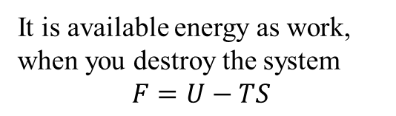




Term “Free Energy” is misnomer
The energy that comes free is TS – that is subtracted from system’s energy U, to get F
So, F should be called “costly” energy
It is available energy as work, when you destroy the system
$$F=U−TS$$
- TS
U | F
H | G
$$U−TS=F$$
$$U−TS+PV=G$$
$$F+PV+TS=H$$
+PV
$$H−TS=G$$
$$G+TS−PV=U$$
$$U+PV=H$$
$$F+PV=G$$
These functions, U, H, F and G are collectively called Thermodynamic Potential

Slide 5


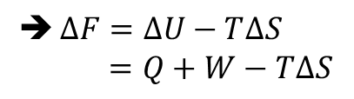





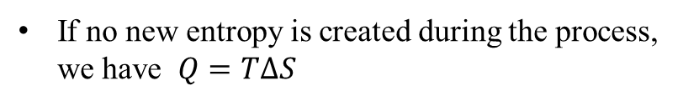
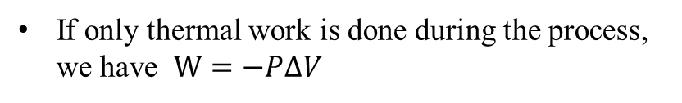

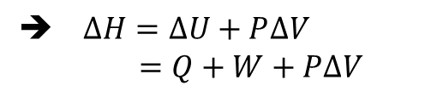

Usually, we deal with processes those do not entirely create or annihilate, rather they are less dramatic
In such situations,
Change is more important
For constant Temperature
$$F=U−TS$$
$∆F=∆U−T∆S$
$=Q+W−T∆S$
Where $W=−PdV+W_{other}$
If no new entropy is created during the process, we have $Q=T∆S$
Change in Helmholtz Free Energy is precisely equal to Work done on the system
Hence $∆F=W$
If a new entropy is created during the process, we have
$$∆F<W$$
In general, $∆F≤W$
For constant Pressure
$$H=U+PV$$
$∆H=∆U+P∆V$
$$=Q+W+P∆V$$
If only thermal work is done during the process, we have $W=−P∆V$
Hence $∆H=Q$
In general, W$=−P∆V+W_{other}$
therefor $∆H≤Q$

Slide 6

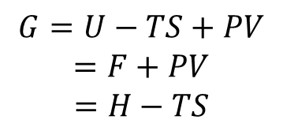

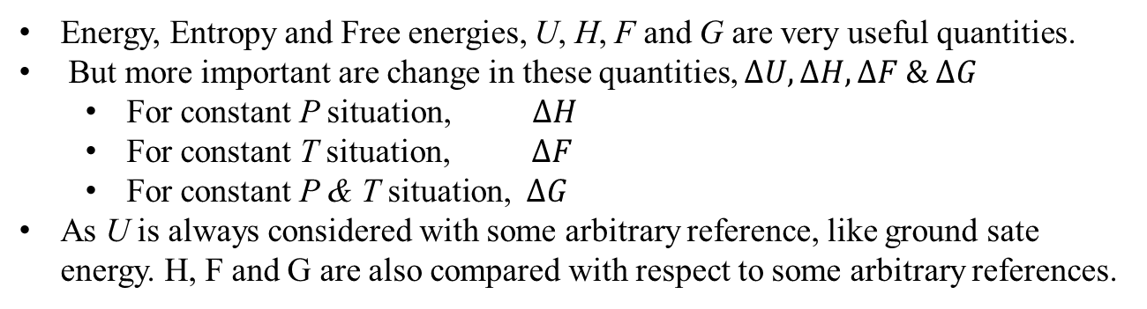






For both P and T constant
We need Gibb’s Free Energy
$$G=U−TS+PV$$
$$=F+PV$$
$$=H−TS$$
➔ $∆G=∆U−T∆S+P∆V$
$$∆G=Q+W−T∆S+P∆V$$
$$But W=−P∆V+W_{other}$$
If no new entropy is created $Q=T∆S$
Therefore, $∆G=W_{other}$
If any new entropy is created $Q<T∆S$
Therefore, $∆G<W_{other}$
In general, $∆G≤W_{other}$
Conclusion:
Energy, Entropy and Free energies, U, H, F and G are very useful quantities.
But more important are change in these quantities, $∆U, ∆H, ∆F \& ∆G$
  For constant P situation, $∆H$
  For constant T situation, $∆F$
  For constant P & T situation, $∆G$
As U is always considered with some arbitrary reference, like ground sate energy. H, F and G are also compared with respect to some arbitrary references.

Slide 7


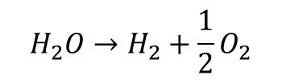
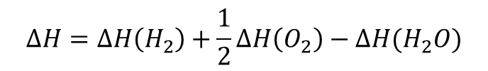

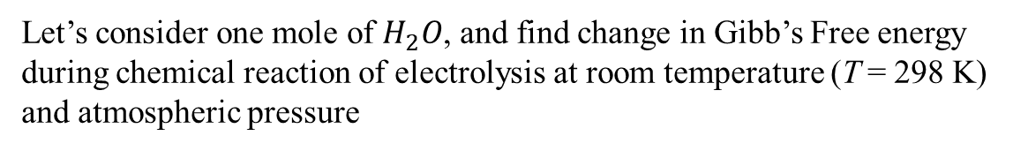



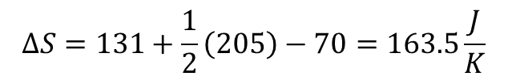



Electrolysis & Fuel Cell
Let’s consider one mole of $H_{2}O$, and find change in Gibb’s Free energy during chemical reaction of electrolysis at room temperature (T = 298 K) and atmospheric pressure
$$H_{2}O→H_{2}+\frac{1}{2}O_{2}$$
$$G=H−TS$$
→ $∆G=∆H−T∆S$
As T is constant
We need $∆H \& ∆S$
$$∆H=∆H\left(H_{2}\right)+\frac{1}{2}∆H\left(O_{2}\right)−∆H(H_{2}O)$$
See page 404 - 405
Liquide water
$$∆H=0+0−(−286 kJ)$$
286 kJ
This is the amount of energy you need to put into this reaction.
Out of 286 kJ, 4 kJ of energy will be used to push the environment out to make space, only 282 kJ of energy will remain in the system
OR This the amount of heat you can get if you burn 1 mole of H₂
Now $∆S=S\left(H_{2}\right)+\frac{1}{2}S\left(O_{2}\right)−S(H_{2}O)$
See again p:404 - 405
$$∆S=131+\frac{1}{2}\left(205\right)−70=163.5\frac{J}{K}$$
➔ $T∆S=(298K)(163.5\frac{J}{K})$
$$≈49 kJ$$
$$∆G=286kJ −49kJ$$
$$237kJ$$

Slide 8
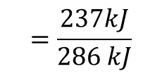


Fuel Cell
If electrolysis reaction is reversed, we can extract electric work
In other words, we can burn 1 mole of H₂ to obtain 237 kJ of electric energy
The principle of Fuel Cell
This can replace combustion engine in future
In a fuel cell, the heat in 286 kJ
Heat expelled 49 kJ
This is to get rid of excessive entropy
The useful work, electric work 237 kJ
Therefore, the efficiency $e=\frac{Work}{Cost}$
$$=\frac{237kJ}{286 kJ}$$
$$≈83\%$$
Practically it may be less but will still be a lot as compared with combustion engine’s efficiency 20 – 30 %
In addition, the exhaust will be water only

Slide 9

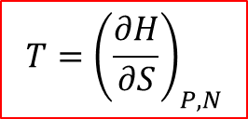
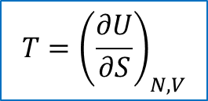





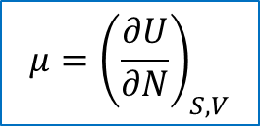
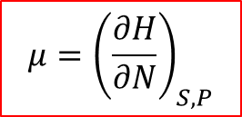

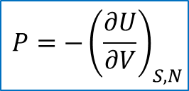

Thermodynamic Identities
Remember, 1st Law
$$dU=TdS−PdV+μdN$$
As $U=U(S,V,N)$
$${T=\left(\frac{∂U}{∂S}\right)}_{N, V}$$
$${P=−\left(\frac{∂U}{∂V}\right)}_{S, N}$$
$${μ=\left(\frac{∂U}{∂N}\right)}_{S, V}$$
We can get similar relations from S(U, V, N)
We can also find similar relationship of thermodynamic identities from Enthalpy H, Helmholtz Free Energy F and Gibb’s Free Energy G.
Enthalpy
$$H=U+PV$$
➔ $dH=dU+PdV+VdP$
$dH=\left(Tds−PdV+μdN\right)+PdV+VdP$
$$dH=TdS+VdP+μdN$$
-- (1)
Hence, $H=H(S,P,N)$
➔ $dH={\left(\frac{∂H}{∂S}\right)}_{P, N}dS+{\left(\frac{∂H}{∂P}\right)}_{S, N}dP+{\left(\frac{∂H}{∂N}\right)}_{S, P}dN$
----------- (2)
Comparing Eq(1) and (2)
$${T=\left(\frac{∂H}{∂S}\right)}_{P, N}$$
$${V=\left(\frac{∂H}{∂P}\right)}_{S, N}$$
$${μ=\left(\frac{∂H}{∂N}\right)}_{S, P}$$

Slide 10

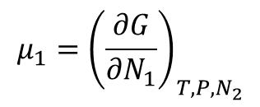









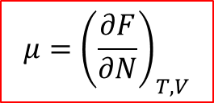
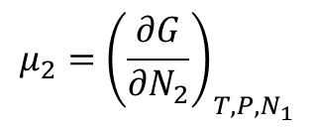
Helmholtz Free Energy
$$F=U−TS$$
➔ $dF=dU−Tds−SdT$
$$dF=(TdS−PdV+μdN)−Tds−SdT$$
$$dF=−SdT−PdV+μdN$$
----- (3)
Therefore, F = F(T, V, N)
➔ $dF={\left(\frac{∂F}{∂T}\right)}_{V, N}dT+{\left(\frac{∂F}{∂V}\right)}_{T, N}dV+{\left(\frac{∂F}{∂N}\right)}_{T, V}dN$
--------- (4)
Comparing Eq (3) and (4)
➔
$${P=−\left(\frac{∂F}{∂V}\right)}_{T, N}$$
$${μ=\left(\frac{∂F}{∂N}\right)}_{T, V}$$
$${S=−\left(\frac{∂F}{∂T}\right)}_{V, N}$$
Similarly for Gibb’s Free Energy
P: 5.8
$${S=−\left(\frac{∂G}{∂T}\right)}_{P, N}$$
$${V=\left(\frac{∂G}{∂P}\right)}_{T, N}$$
$${μ=\left(\frac{∂G}{∂N}\right)}_{T, P}$$
If there are more than one type of particles involved
$${μ_{1}=\left(\frac{∂G}{∂N_{1}}\right)}_{T, P, N_{2}}$$
$${μ_{2}=\left(\frac{∂G}{∂N_{2}}\right)}_{T, P, N_{1}}$$
. . .

Slide 11
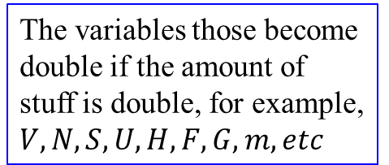
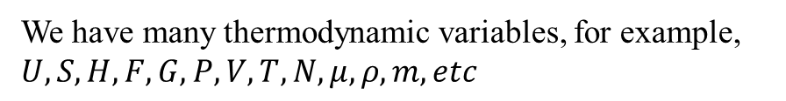
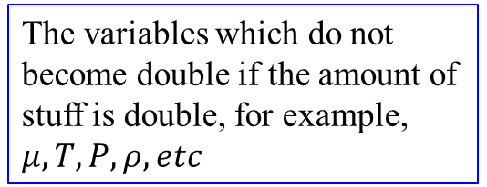
Conclusion
We have many thermodynamic variables, for example, $U, S, H, F, G, P, V, T, N, μ, ρ, m, etc$
They can be divided into two categories
Extensive Variables
Intensive Variables
The variables those become double if the amount of stuff is double, for example, $V, N, S, U, H, F, G, m, etc$
The variables which do not become double if the amount of stuff is double, for example, $μ, T, P, ρ, etc$

Slide 12
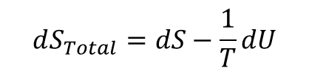





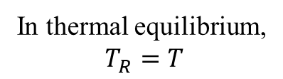
Free Energy is a Force towards Equilibrium
We know for an isolated system $∆S≥0$
➔ The system’s entropy governs the direction of spontaneous change
What if a system is not isolated?
Suppose that a system is in good thermal contact with environment
The system can exchange energy with environment
Now we can not say that system’s entropy tends to increase
But we can say
As environment can be considered as an ideal reservoir – can absorb or release heat without changing its temperature
$$dS_{Total}≥0$$
We also know
$$dS_{Total}=dS+dS_{R}$$
---------- (1)
$$dU=Tds−PdV+μdN$$
➔ $dS=\frac{1}{T}dU+\frac{P}{T}dV−\frac{μ}{T}dN$
---------- (2)
For a reservoir, if V and N remain constant
$dS_{R}=\frac{1}{T_{R}}dU_{R}$ and ${dU}_{R}=−dU$
----- (3)
In thermal equilibrium,
$T_{R}=T$
$$dS_{Total}=dS−\frac{1}{T}dU$$
Eq (1) ➔
---------- (4)

Slide 13
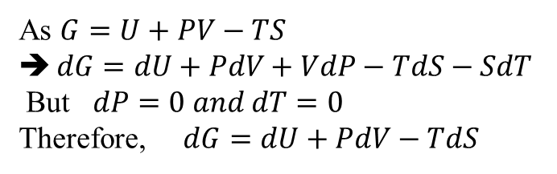
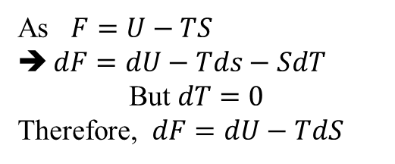
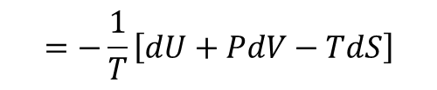
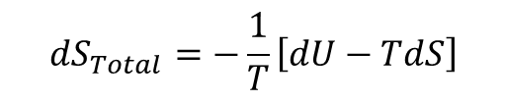
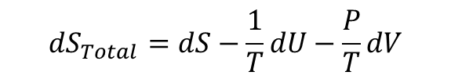
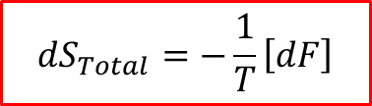

$$dS_{Total}=−\frac{1}{T}\left[dU−TdS\right]$$
As $F=U−TS$
$dF=dU−Tds−SdT$
But $dT=0$
Therefore, $dF=dU−TdS$
$$dS_{Total}=−\frac{1}{T}\left[dF\right]$$
Condition: T, V and N are fixed (constant)
An increase in total entropy results in decrease of Helmholtz Free Energy of the system
To achieve thermal equilibrium, F must be minimum
What about the case, when P, T and N are fixed instead of V, T and N ?
Now we will have
$$dU_{R}=−dU and dV_{R}=dV while dN=0$$
Eq (2) ➔
$$dS_{Total}=dS−\frac{1}{T}dU−\frac{P}{T}dV$$
$$=−\frac{1}{T}\left[dU+PdV−TdS\right]$$
As $G=U+PV−TS$
$dG=dU+PdV+VdP−TdS−SdT$
But $dP=0 and dT=0$
Therefore, $dG=dU+PdV−TdS$
$$dS_{Total}=−\frac{1}{T}\left[dG\right]$$
For fixed P, T and N
Increase in total S results decrease in Gibb’s Free Energy of the system

Slide 14
Summary
Note: N is fixed (constant) in all following cases
Isolated system U and V are fixed → S of the system tends to increase
For non-isolated system
Thermal equilibrium with environment
T and V are fixed → F of the system tends to decrease
Thermal and Mechanical equilibrium with environment
P and T are fixed → G of the system tends to decrease
Entropy of the environment can increase in two ways:
Environment can absorb energy from the system, U of the system decreases
OR
It can acquire volume from the system, V of the system decreases
This will assure, maximizing the entropy of the universe

Slide 15
Assignment # 7 Due 4/1/2022
5.2, 5.5, 5.14, 5.16 & 5.22
Problems for practice of Ch 5:
5.1, 5.8, 5.10, 5.20, 5.23, 5.24, 5.25, 5.28, 5.32 (a, b), 5.35 and 5.47

